Slide 1
DATA PREDICTION – Sale Projection per Strategy
Load historical quarterly data
Get predicted data per each strategy for the nearest Q by regression analysis method
Combine historical Sale% each Strategy with forecast from Sale team
Modify at details level as per plan for that Q

Slide 2
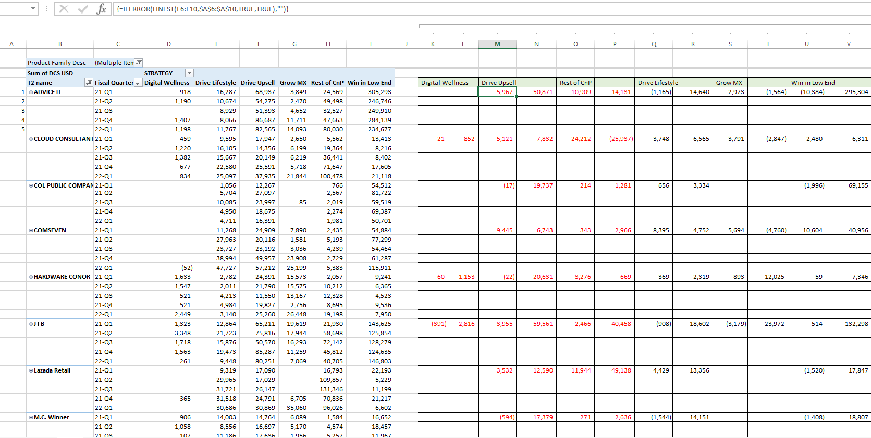

Slide 3
